Slide 1
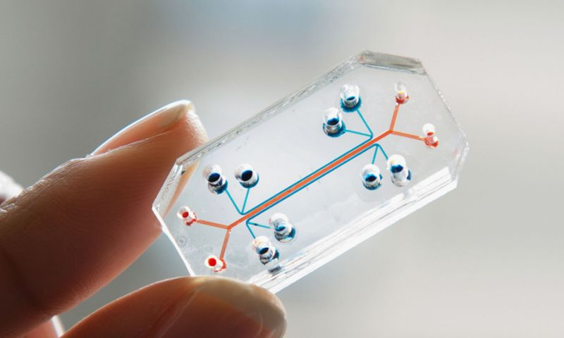
Organs on a chıp technology
Assoc. Prof. Dr. AlI AKPEK
Yıldız TechnIcal unIversIty,
Bıomedıcal engIneerIng department

Slide 2
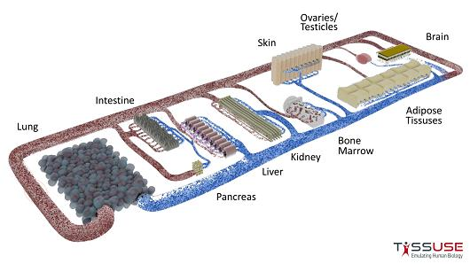
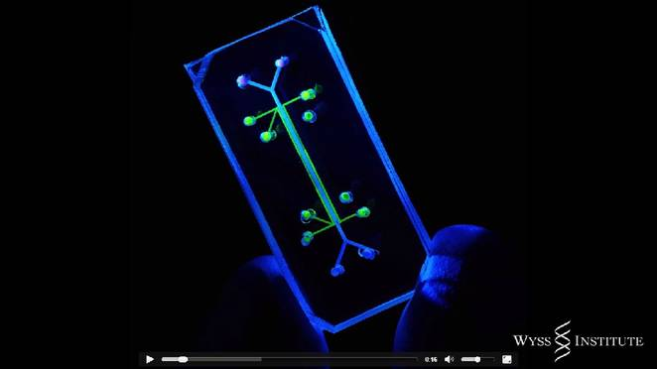
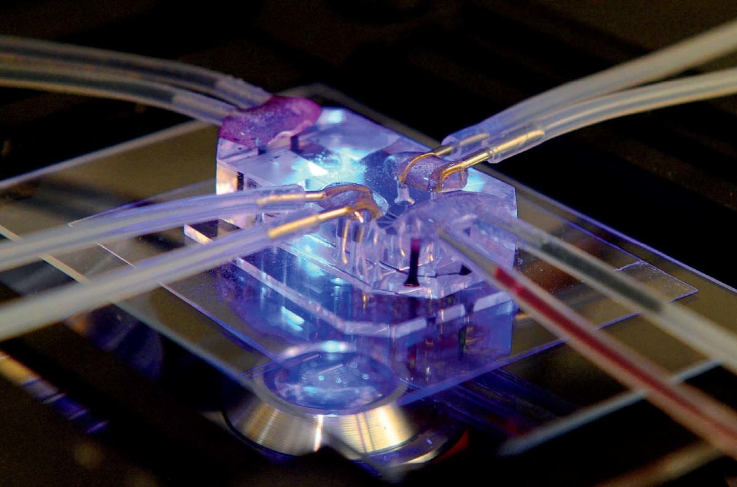
What Is Organs on a chIp?
It is a multichannel 3-D microfluidic cell culture chip which simulates the activities, mechanisms, physiological response of entire organs.
These micro devices are translucent, they provide a window to watch inner workings of human organs.
This technology is being used to develop a whole pipeline of human organs on a chip such as lung, gut, liver, heart, skin, bone marrow, pancreas, kidney, eye and even a system that mimics the blood brain barrier.
One day, they will perhaps abolish the need for animals in drug development and toxin testing.
Microfabrication, microelectronics and microfluidics offer the prospect of modeling sophisticated in vitro physiological responses under accurately simulated conditions.

Slide 3
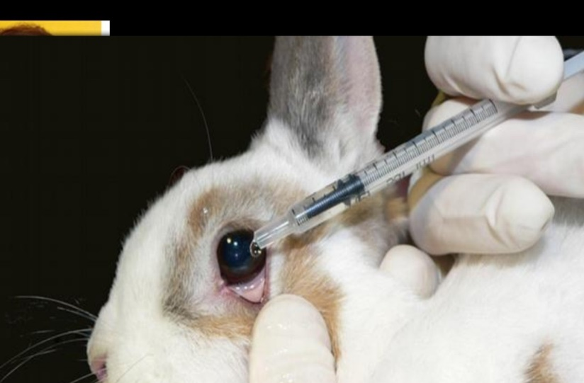
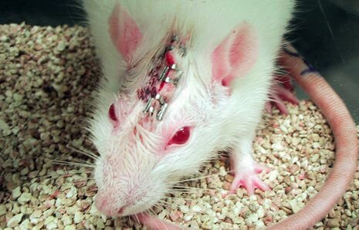
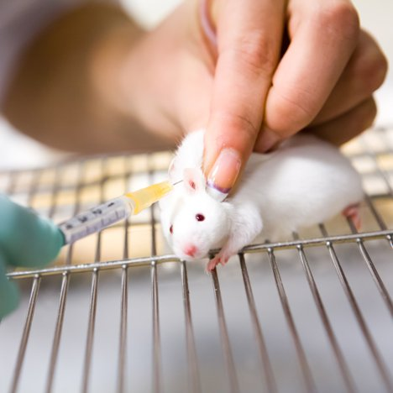
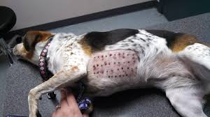
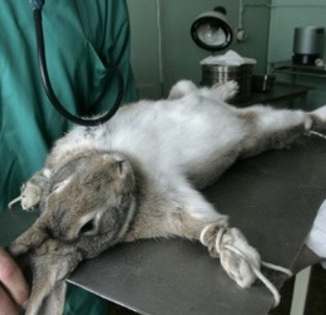
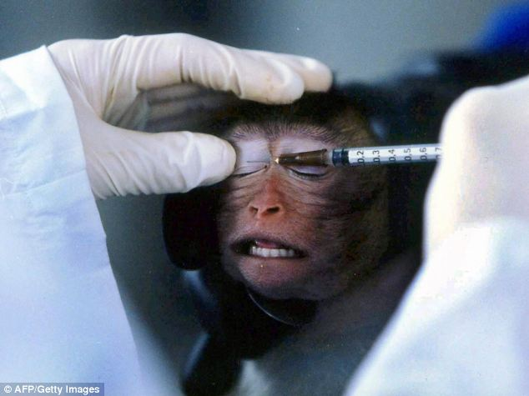
WHY DO WE NEED ORGANS ON A CHIP TECHNOLOGY?
Drug Testing in animal models is time consuming, costly and often does not predict the adverse effects in humans and also 60% of animal models are not able to predict the toxicity. (Hamelton et al 2011)
3D Culture models promote levels of cell differentiation not possible in conventional 2D Culture systems.
3D Culture systems is a large microfabrication technologies from the microchip industry and microfluidics.
It approaches to create cell culture microenvironments
This technology supports both tissue differentiation and recapitulate the tissue-tissue interfaces, spatiotemporal micro gradients and mechanical microenvironments of living organs.
This organs on chips permit the study of human physiology in an organ specific context, enable novel in vitro disease models, and could potentially serve as replacements of animals used in drug development and toxicicty testing

Slide 4
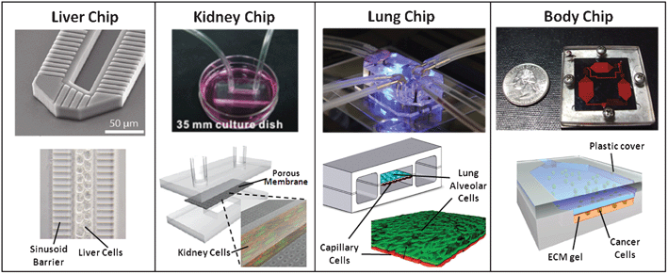
Conventıonal applıcatıons

Slide 5
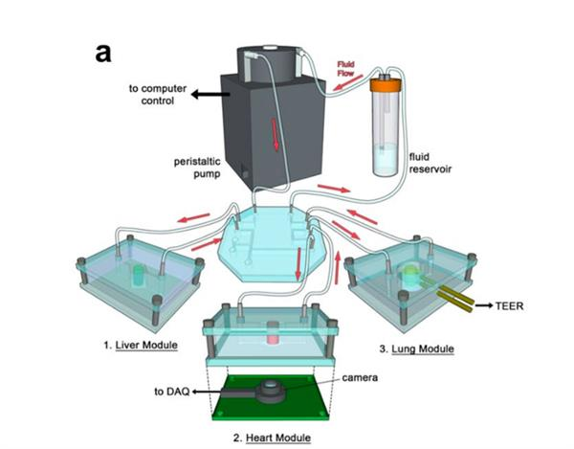
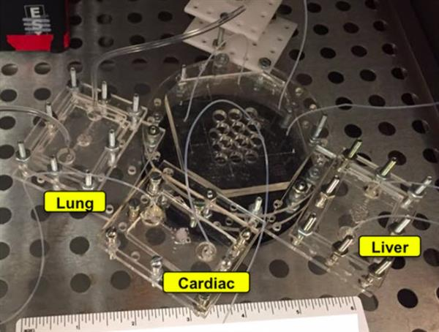
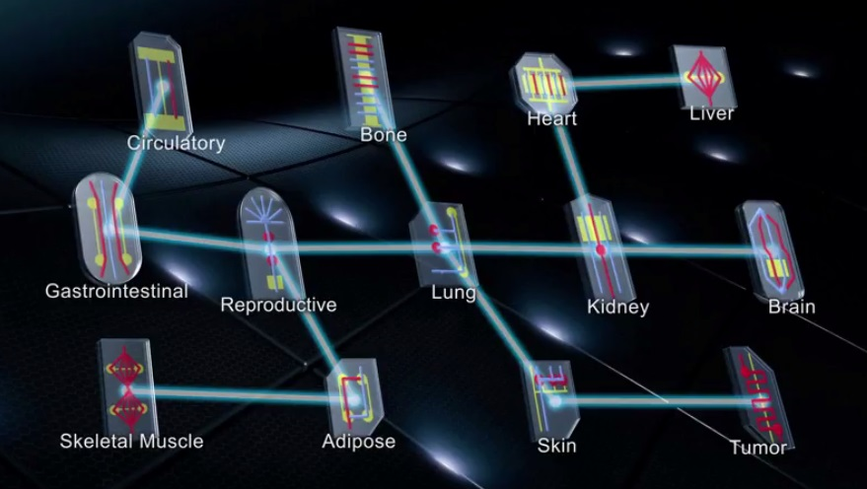
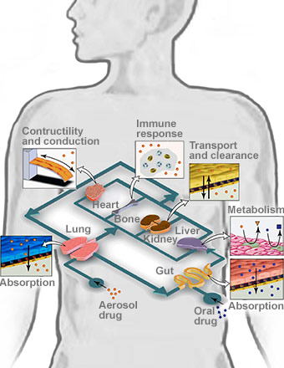
Human on a CHIP

Slide 6
ORGAN ON A CHIP and PHARMACEUTEICAL INDUSTRY
Replace animal models.
Help the laboratories reach the stage of clinical trials.
Comparison studies of drugs on human and animals.
Study on interactions of pathogens and organ cells, and also the mechanisms of some virus attacks.
To study the effect of drug on its main action of site and also other organs.
Study of toxicity of drugs and cosmetics.
To study about cancer cells and produce new drugs in cancer treatment.
Ensure better regulatory decision-making.
Develop vaccines and drugs to counter bioterrorism threats.

Slide 7
ORGAN ON A CHIP and PHARMACEUTEICAL INDUSTRY
This technology would help more in pharmacological studies.
It is used to study concentration-time profiles, drug absorption, bioavailability, metabolism, excretion ,when all the appropriate parameters of drug are known.
It would also help companies to pinpoint whether a dose of a drug is both effective and safer.
Ultimately , organs on chip, an innovative technology would help in drug development and new drug discoveries which will revolutionize the pharmacy field in the future.

Slide 8
Some challanges for new technology
New technology must meet a market need
Winning grants is helpful but is not same as winning customers
Millions of $ from VC’s does not guarantee success (money does not change the laws of physics)
Early engagement with customers is essential
Obtaining representative human cells
Media selection for co-culture of different cells
Seeding cells inside microstructured chambers
Getting adequate nutrient and oxygen to cells
Connecting multiple chambers and flowing media
Getting enough biological material for an accurate assay

Slide 9
DISaDVANTAGES
Every property of an organ cannot be measured.
It is some times not possible to study complete organ.
Drugs action during pregnancy cannot be studied.

Slide 10
FUTURE
Relatively smaller 3D experimental setups with the capability of controlling the positions of cells and tissue - tissue interfaces, transcellular molecules, and their concentration gradient will be advantageous to analyze new drugs-on-chips systems to obtain more accurate results than animal models.
Organ-on-a-chip systems will potentially replace animal testing, or at least reduce it, thus eliminating the ethical issues often raised by animal rights groups.
Achievements in the organ-on-a-chip field can reduce the amount of testing determined before and during clinical trials in human patients.
Combination of gene-replacement technology with the stem cells from an individual patient might lead to personalized medicine or treatment and disease models.

Slide 11
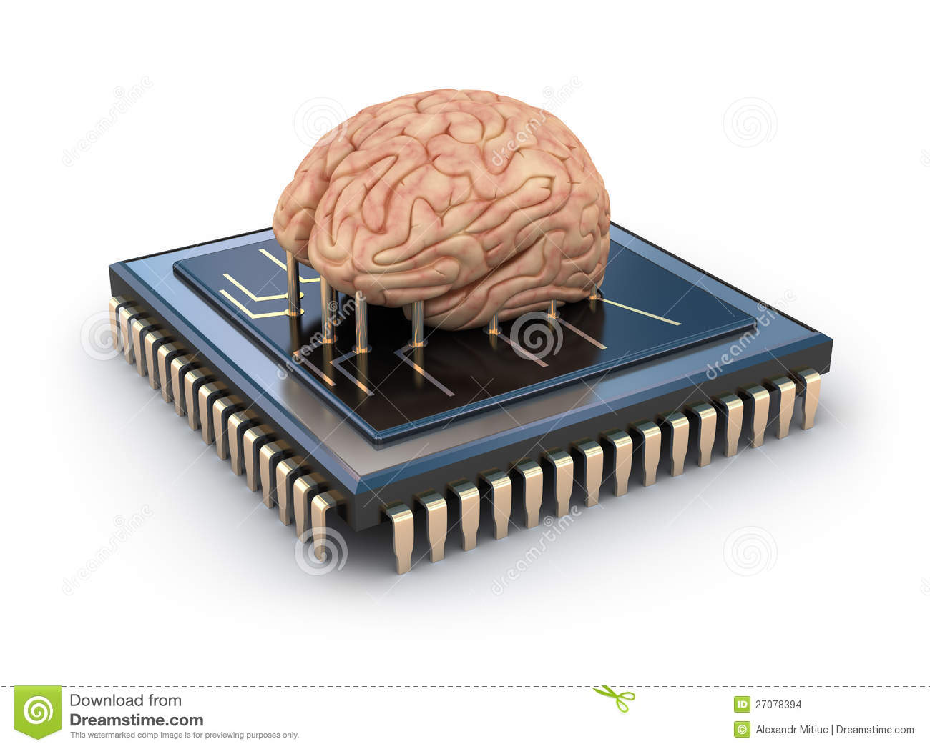
End of the chapter

